Slide 1
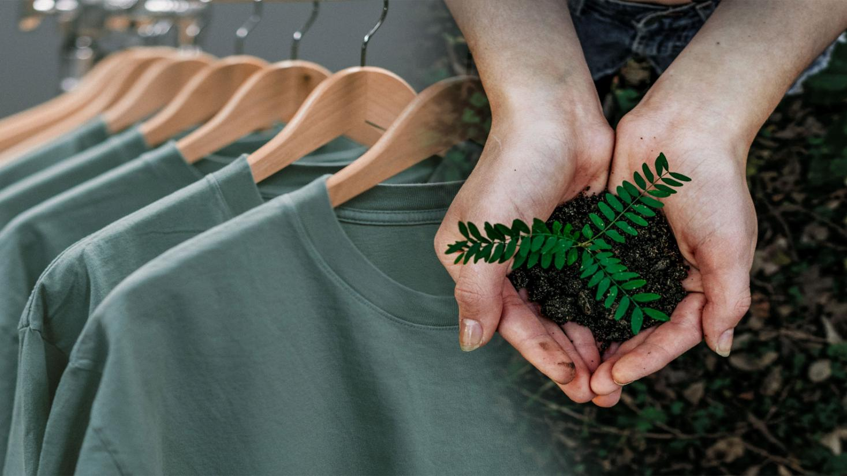
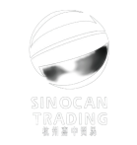
Hangzhou Sinocan Trading co.
-- a responsible fashion maker

Slide 2
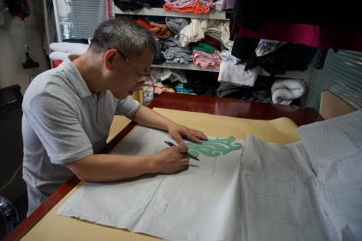
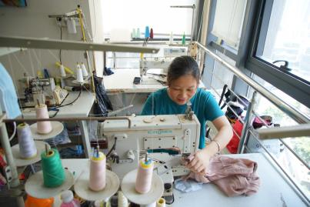
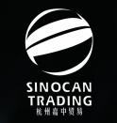
Hangzhou Sinocan Trading: a responsible fashion maker `
* Who we are: Your responsible fashion supply chain solution.
We are responsible for your orders. Started as a fashion production trading company in 2009, Hangzhou Sinocan has developed into a conglomerate of R&D, agent, trade, production and distribution for responsible fashion products, specialized in knitwears.
We have our own fabric sourcing team and in-house sample room to satisfy customer’s development requests.
Pattern Making
Fabric and Accessory Sourcing
In-house sample room

Slide 3
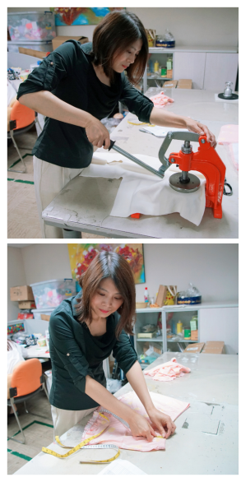
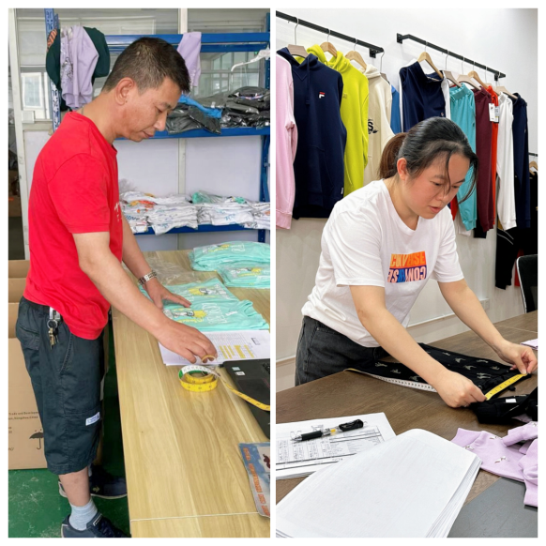
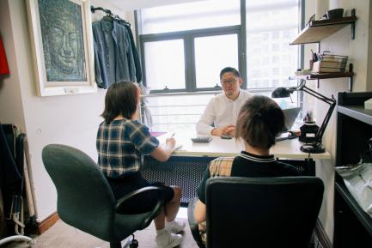
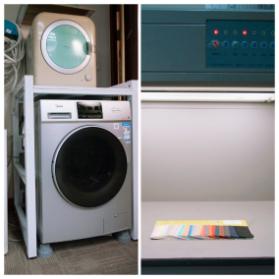
Hangzhou Sinocan Trading: a responsible fashion maker `
We have a professional team of to ensure high quality and ontime delivery of bulk as well as samples.
Order following meeting
Sample inspection
Bulk inspection
In-house test centre

Slide 4
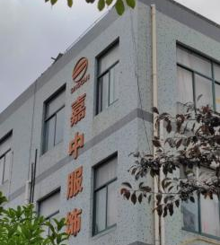
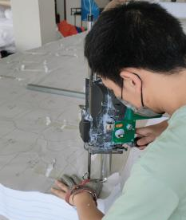
Hangzhou Sinocan Trading: a responsible fashion maker `
We are responsible to workers and consumers.
We have co-ventured factory: Ningbo Sinocan Garment co, so as to control quality, delivery and service better.
We also have cooperating factories who all passed at least one social factory audits (such as BSCI, WRAP) to ensure safty of our workers an
factory campus
Needle detect protocol
& auto snap machine
cutting with
iron glove
workshop

Slide 5
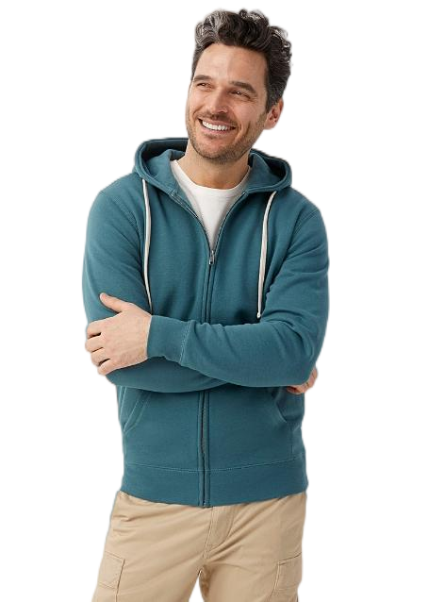
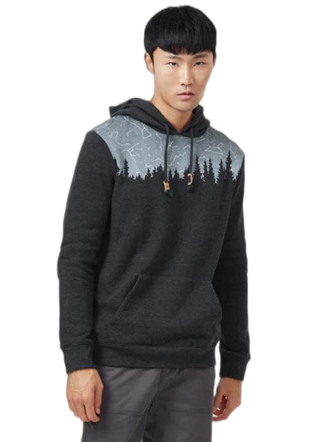
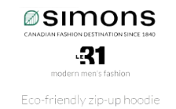
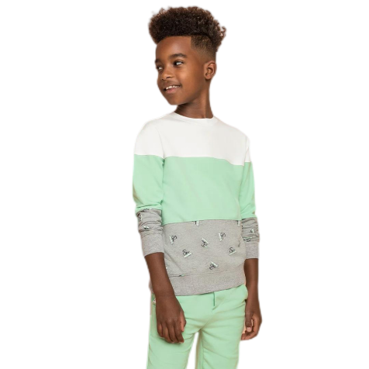
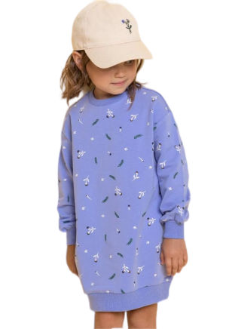
Hangzhou Sinocan Trading: a responsible fashion maker `
We are responsible to our mother nature.
We incline to work with responsible fashion brands. Such as, Lemur group (kids brand MILES THE LABLE using organic cotton only), La Maison Simons (Twik hoody with recycled polyester), Tentree (Use eco-friendly material only, plant 10 trees) , La Vie En Rose, and so on.

Slide 6
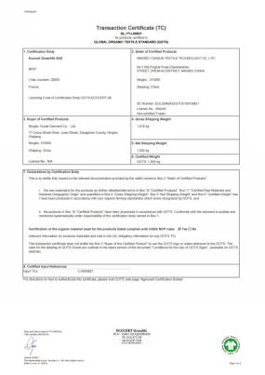
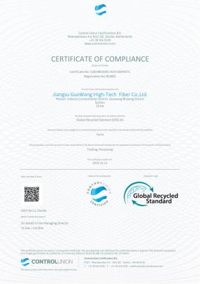
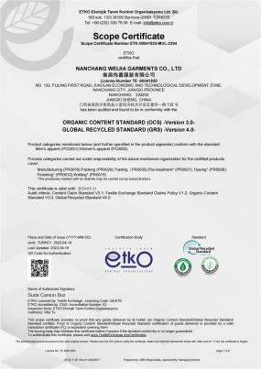
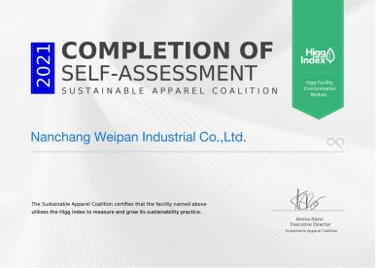
Hangzhou Sinocan Trading: a responsible fashion maker `
We are responsible to our mother nature.
For those eco-friendly products, we use high quality, organic cotton, recycled polyester, bamboo fibre, and other ecological materials with repliable certifications. Our factories are also certified as meet with eco-friendly standards.
We also use green packing materials such as recycled paper tag, recycled pulp made cartons, totally degenerable polybags, etc.
Factory Higgs Certification
Organic Cotton Certification
Recycled Polyester Certification
Factory ETKO Certification

Slide 7
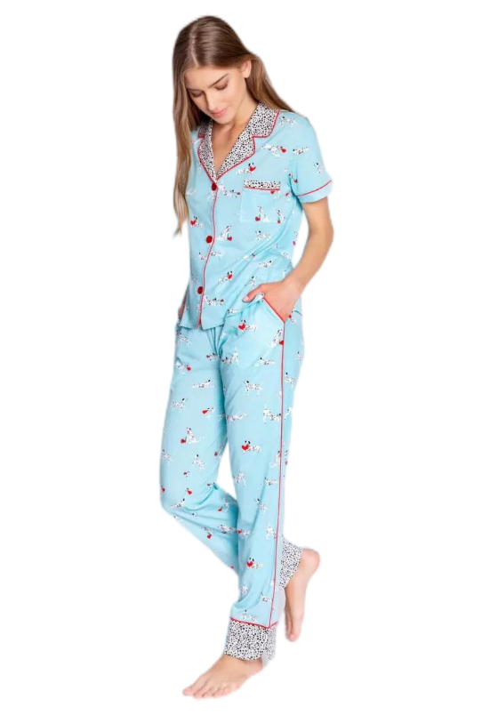
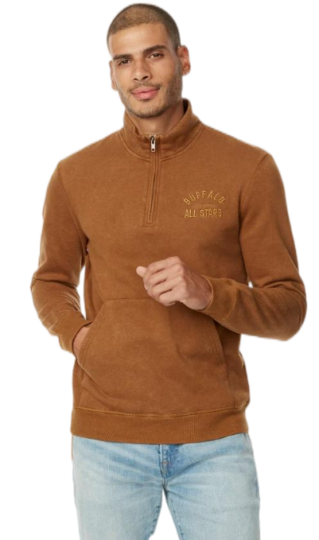
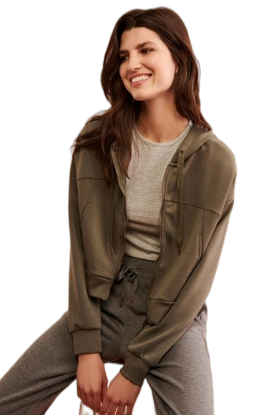
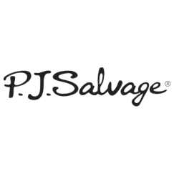
Hangzhou Sinocan Trading: a responsible fashion maker `
We also work with other customers such as:
- PJ salvage (USA, famous pajama brand)
- Buffalo by David Bitton (Canada)
- Aubainerie (Quebec)

Slide 8
Hangzhou Sinocan Trading: a responsible fashion maker We wish to work with you in the near future. Contact: leoqiu@sinocantrading.cn Wechat and China mobile: 13958084630 Office Address: Room 1407, 337 Shaoxing Road, Hangzhou, China. 310014 `

